Slide 1
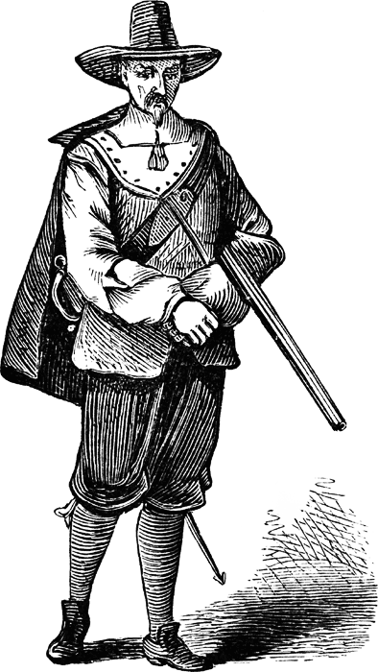
Puritans Beliefs
Personal salvation depends solely on the grace of god –predestination/fate
Human beings were inherently evil and so must struggle to overcome their sinful nature
Saw guilt and remorse as a sign of God’s grace and thus evidence of their election to heaven
Valued hard work, community over the individual, thrift, and piety

Slide 2
Discussion Questions
What are Anne’s final thoughts? How does she reconcile her tragedy?
What does she mean by “Farewell, my pelf…”?
What quality does the meter and rhyme scheme bestow upon the poem? What tone is produced?
In what ways is Anne’s viewpoint consistent with Puritan ideology?

Slide 3
On the slip of paper…
Do not write your name
Write down 3 objects that you would grab on the way out of your burning house.
On the back, choose one of the objects and write 2-3 sentences that describe why this item is important to you and shouldn’t be considered “pelf”

Slide 4
Introductions
When you introduce your classsmate please use complete sentences and state:
Their name
Their grade
Favorite food to make or eat
Their objects
Paraphrase their reasoning for why those objects are important to them

Slide 5
